Slide 1
ACT Non-College Reportable
2024-2025
SPRING: 03/11/2025 – 03/21/2025
Notes:
Update contact list
Cost
*NOTES FROM LAST YEAR!
Talk about irregularity reports. Don’t invalidate a test just because a student misses the 2nd day of testing – ACT will score the part that he completed.
Notify us if you have any of these so that our numbers are correct when we verify the results
If the test administrator does not know the student you MUST verify the student’s ID!

Slide 2
Reminders
Students only have to take the sections that they need to meet graduation requirement
All students must be listed in Pearson Access Next to test (issued an ACT ID)
Check your upload extract in shared drive to verify who is uploaded
Scott will put the extract in the drive about a week out to ensure accuracy
You can/should have a list that you are working with from FOCUS

Slide 3
Students to Test
Evaluation Services will Pre-ID ALL grades 10(R)-12 students who have not yet met:
ELA mastery (graduation) and who have attempted PM3
Algebra 1 mastery (graduation)
Ensure you are using the FOCUS enrolled grade, not the grade where a student “should be”!
Not a mandatory test, so schools must notify parents and allow them to opt out

Slide 4
Examples
Heather is a 12 grade student who has not yet met her FSA ELA mastery.
She needs to take ENGLISH and READING on the ACT-NCR ONLY (in order given)
Nate is an 11th grade student who has not yet met his Algebra EOC mastery
He only has to take the MATH section on the ACT-NCR
Robin needs both FSA ELA and Algebra 1 mastery to graduate
She must take ENGLISH, MATH, and READING (In correct order given) on ACT-NCR

Slide 5
What’s New?
Secure Destruction: Within 72 hours after testing, you should arrange for secure destruction of all forms (except the Testing Staff List, Scribe Agreements, Readers Agreements, and Interpreter Agreements which must be retained for one year)
Translated test directions: Available on ACT-hosted website
Answer Documents: No longer lists year. Examinees will now have an apostrophe to grid for their f/l name
Materials: All secure and non secure will ship together
Scribe/Reader/Interpreter agreements: On ACT-hosted website

Slide 6
NEW!!
ACT-NCR allows a read aloud function for ALL students
Do not have to have an IEP or 504 plan to utilize
Audio on reading portion reads the passage as well as the items/answer choices
Audio is specific to the FORM # that the student is given, so you may have multiple forms in a group
Audio is pre-recorded and accessed via a website
IT will configure GoGuardian to allow the URL
You will email Latresa Carlisle the URL provided by ACT

Slide 7
Preparation – General
Receive and inventory Non-College Reportable materials
Keep your boxes for returning materials
Apply barcode labels to answer documents in designated area
Recommended to barcode the day of, in the event of absences
Hand grid student information if you don’t have a label
Store materials securely
Train test administrators/proctors
Email Heather the date your school plans to test

Slide 8
Preparation - Materials

Slide 9
Preparation - Staff
Room supervisors and proctors may be current or retired faculty members, school admin or clerical employees, substitutes, student teachers, or paraprofessionals
May not serve as test coordinator if a relative is testing in the ACT window
Relative is: children, stepchildren, grandchildren, nieces, nephews, siblings, in-laws, spouses, and persons under your guardianship.
Staff must remain attentive to their testing responsibilities throughout the administration
Page 11 Test Coordinator manual

Slide 10
Preparation – Staff Training
School test coordinator is responsible for providing manuals, supplements, and training to all test site staff before test day.
Training needs to cover:
Facilities (Room) requirements and set up
Test Materials
Non-Test Activities
Test Administration
https://share.act.org/watch/X9P2E825s3EtnVRv81NCBp
Detailed outline begins on page 21 in the Test Coordinator Manual
Pages 17-18, Test Coordinator Manual

Slide 11
Preparation – Staff List

Slide 12
Preparation – Proctors
**NCR Manual has 1-20 ratios, but we have permission to use standard time proctor rules per ACT.
Notes:
The proctor requirements are the same as the standard time test. Once you reach 50 students, an additional proctor is required for each additional 50 students.

Slide 13
Preparation – Test Room Setup
Students should all face the same way
Students should be at least 3 feet apart
Carrels are not allowed
Remove visual aids
Specifics for desks, tables by type, etc.
Pages 8-10, Test Coordinator manual

Slide 14
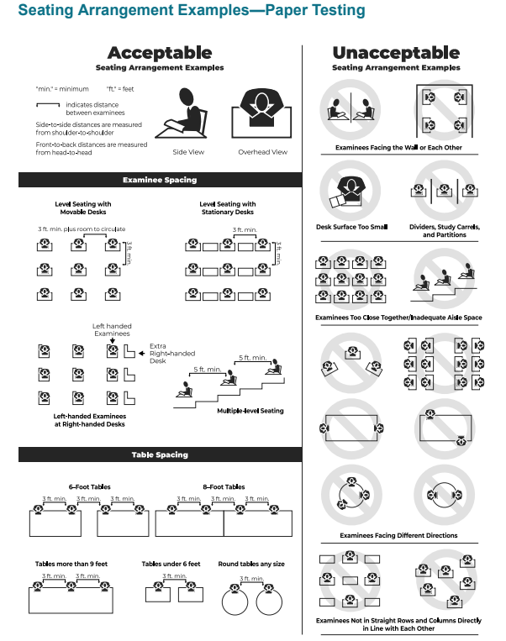
Page 10, TC Manual

Slide 15
Preparation – Materials
Make sure you are using this manual for all timing scripts and directions!

Slide 16
Preparation – Materials
Test materials are sent for a specific date and type (regular or NCR).
Schools must ensure they use correct materials during the test window
Secure
Test Books
Non-Secure
Barcode labels
Answer documents
Applicable supplements (i.e. Calculator Policy)
Site Header
Administration manuals
Return materials

Slide 17
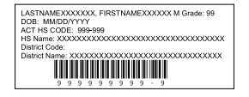
Preparation – Materials
Check barcode correctness – if incorrect, manually grid the correct student code in Block U
Apply barcode in the correct location

Slide 18
Preparation - Materials

Slide 19
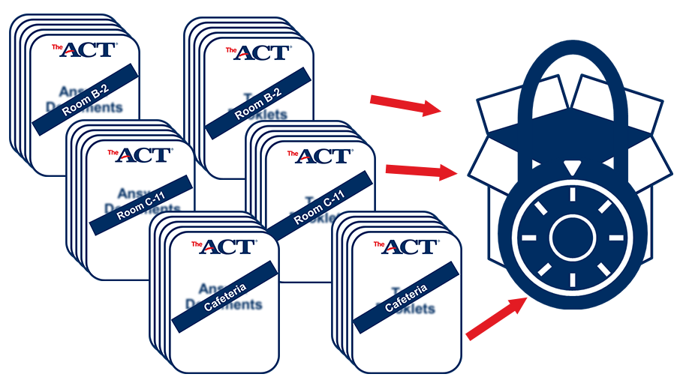
Preparation – Room Materials
Testing Manual (contains irregularity report)
Test Room Report with test site, room info & roster
Answer documents and test booklets by room
Seating Chart (District req’t)
Calculators
Pencils & erasers

Slide 20
Preparation - Calculators
Make sure you are only handing out/allowing
authorized calculators
Policy prohibits sharing of calculators, so make
sure you have backups
If a student uses a prohibited calculator, the test
will be invalidated

Slide 21
Test Day – Guidelines
Timing options (next slide) – if not followed, fill out Irregularity Report
Tests can be given in a Time-and-a-Half, Single Session/Multi Day, Double Time, Multi Day, or Triple Time, Multi Day
Whatever timing is chosen MUST be used for each subtest (cannot mix and match timings)
Students must take the tests in order
(English, Math, Reading, Science)
Schools MAY opt to not give the Science subtest (not used for a concordant score calculation)
Lunch can be scheduled between tests
Notes:
Can move on once all students have finished that session – Eng (70), Math (90), Reading (55), Science (55)

Slide 22
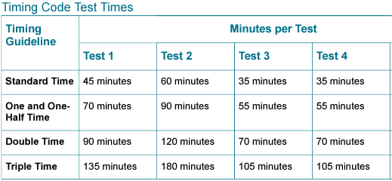
Test Day – Timing Options
If using multiple days, each test must be completed in one session
English Math Reading
215/3.5
280/4.6
420/7

Slide 23
Test Day – Timing Options
Time-and-a-half, single session
Page 55, NCR manual
Time-and-a-half, double or triple time, over multiple days
Page 63, NCR manual
Session must be completed in same day (cannot split a session)
No Double/triple time, single day allowance. If a student has a double time, multiple day timing must be used.

Slide 24
Test Day – Reminders
Electronic devices are prohibited (with the exception of chromebooks if you are using Read Aloud)
Calculators are allowed during the math test only
Collect and pack materials after testing (see manual)
Answer documents must be in the envelope
Include irregularity reports (if any)
Make copies of all admin records to keep on your campus
Return materials to ACT right away – dispose per new 72 hour guidelines
Email Heather when you have shipped your materials

Slide 25
Test Day – Attendance
ACT Attendance Roster
Staff MUST initial that they have verified student’s identity
List students “Actually Testing” in the room
List serial numbers of the test booklet(s) “Actually Used”
This is per ACT’s policy listed on their website

Slide 26
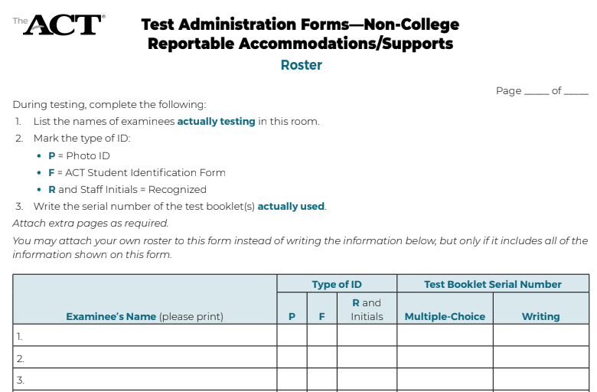
Staff must initial that they
recognize the student

Slide 27
Test Day – Seating Diagram

Slide 28
Test Day – Handling Materials
Room supervisors will pick up materials from SAC
To ensure security of test materials, distribute to examinees ONLY when directed to do so in the instructions, not before
Be sure each examinee receives the answer document with his or her name on the barcode label or the student code gridded in Block U (another way to verify attendance)
Personally hand one test booklet individually to each examinee in sequential serial number order
Explained on page 23 in the NCR manual

Slide 29
Test Day – Handling Materials
After Testing, room supervisors must:
**Also ensure grade level is filled/bubbled in on the answer sheet
Go over this at your staff training, and reinforce that this is how you
want materials turned back in to you after testing

Slide 30
Test Day – Irregularities
Fill out the Irregularity Report for each occurrence of a group or individual irregularity (if there are none, do not submit IR)
Group
Missing or stolen test materials
Interruptions or disturbances
Emergency evacuations
Power outages
Reschedules
Pages 35, NCR manual
Individual
Pages 36, NCR manual

Slide 31
After Testing
Mark on your testing file which students tested/did not test in the shared Google Drive for your school
ONLY use column marked “Tested? Yes/No”
Do NOT edit/delete/add anything else to this file!

Slide 32
After Testing
Once you have tested, you may ship back all test materials – do not hold them at your schools
ACT will report scores at 4, 7 & 9 weeks – so the sooner your materials are returned, the sooner you MAY see your scores
If you need access to ACT Success, email Heather or Nate
Deadline for test file update is MARCH 26, 2025

Slide 33
Google Drive

Slide 34
Payment
Schools are paying for these tests
We will send you a list of all students that were in the PreID (have not met the ELA/Algebra 1 grad requirement )
Immediately after testing 1) mark the students that tested in the shared Google Drive for your school
Eval Svcs will unenroll students that did not test
Schools will be charged for unused tests UNLESS students are unenrolled from PAN before the end of the window!

Slide 35
Questions
Contact Evaluation Services
Heather Rykard (Test Procedures, Administration, Accommodations)
850-469-5387
hrykard@ecsdfl.us
Scott Dodson (Pre-ID, Testing Data files, Score reporting)
850-469-5389
sdodson@ecsdfl.us

Slide 36
Resources

